Slide 1
Florida East Coast Baptist Association 2020 Virtual Joint Session Moderator Toby Philpart
The Work and Worship of the Trustee Workshop
October 26-27, 2020
5:30 p.m. – 6:45 p.m.
Dr. Brett Snowden, Pastor

Slide 2
Introduction

Slide 3
OUR VIRTUAL CLASS NORMS
Be
Be present
Be
Be Engaged
Be
Be Respectful of others and self
Be
Be Ready to leave this class learning something “new.”

Slide 4
AGENDA
Baptist Distinctives
Trustees as Officers
Defining the trustee
Marks of a trustee
Spiritual gifts
The 4M Factor
Functions of the trustee ministry
Duties
Money Management, Budget & Cash Flow
A God Approved Ministry

Slide 5
BAPTIST DISTINCTIVES
The Bible is the authority for Baptist faith and practice.
Two Church Officers: Pastor and Deacons
"The officers in a local New Testament church are pastors and deacons (Phil. 1:1).The same office is variously called bishop, elder or pastor.“ (Hershel H. Hobbs - The Baptist Faith and Message, p. 69)

Slide 6
DEACONESS
The word diakonos is found in ( Romans 16:1) associated with a female name, and this has led to the conclusion that there existed in the apostolic age, as there undoubtedly did a little later, an order of women bearing that title, and exercising in relation to their own sexuality functions which were analogous to those of the deacons.
It has been concluded that the women mentioned in (Romans 16:6 and
Romans 16:12) belonged to such an order. The rules given as to the
conduct of women in (1 Timothy 3:11; Titus 2:3) have in like manner been
referred to them, and they have been identified even with the "widows" of
(1 Timothy 5:3-10)
The ministry of a deaconess is to assist the Pastor by working with the Deacons in ministering to the needs of the overall congregation - specifically to women, children, elderly, and those in distress - with loving kindness and sympathy.

Slide 7
Distinctives
This means there is no other office or ministry of the church that is above the Pastor and Deacons.
All other offices and ministries are considered ‘help ministries’ because the Bible does not define or address them. Hence, they must be accountable to the Pastor and Deacons.

Slide 8
Distinctives
Baptists believe in congregational church governance and the autonomy of churches.
Governance is in the hands of the church as a whole. The church has the final authority.

Slide 9
Romans 12:11
Not slothful in business; fervent in spirit; serving the Lord; (ESV)

Slide 10
TRUSTEES AS OFFICERS IN GOD’S CHURCH
The establishment of trustees as officers in a local congregation (church) is a requirement by civil law, in some states, and an expedient to the congregation. In most Baptist church’s, trustees assume their office by election through the general congregation.

Slide 11
Effective trustees will function as Christian stewards of property God has entrusted to the congregation.
This includes supervising and maintaining both the physical property of the congregation and gifts made to the congregation so that the ministries of the congregation can be effective, and all legal requirements related to the property are satisfied.

Slide 12
Defining the Trustee
Persons “who manage for others,” or who hold title on behalf of others.”
It means that a church has put its confidence in a group of members and has given them the duty of caring for their material possessions.
Unfortunately, we do not find the word “trustee” in the Bible.

Slide 13
STEWARDS
We are STEWARDS of all that God has given us.
The central essence of a biblical world view stewardship is managing everything God brings into the believer's life in a manner that honors God.
Psalm 24:1 - The earth is the Lord’s, and everything in it, the world, and all who live in it;
1 Chronicles 29:11 - Yours, Lord, is the greatness and the power and the glory and the majesty and the splendor, for everything in heaven and earth is yours. Yours, Lord, is the kingdom; you are exalted as head over all.

Slide 14
Marks of a trustee member

Slide 15
Be a person of god’s word
Open to LEARNING THE WORD and its implications for you.
Old Testament stories concerning the temple of God which have some relevance for trustees. (1 Chronicles 15-26)
Philippians 2:3-4
³ Do nothing out of selfish ambition or vain conceit. Rather, in humility value others above yourselves, ⁴ not looking to your own interests but each of you to the interests of the others.

Slide 16
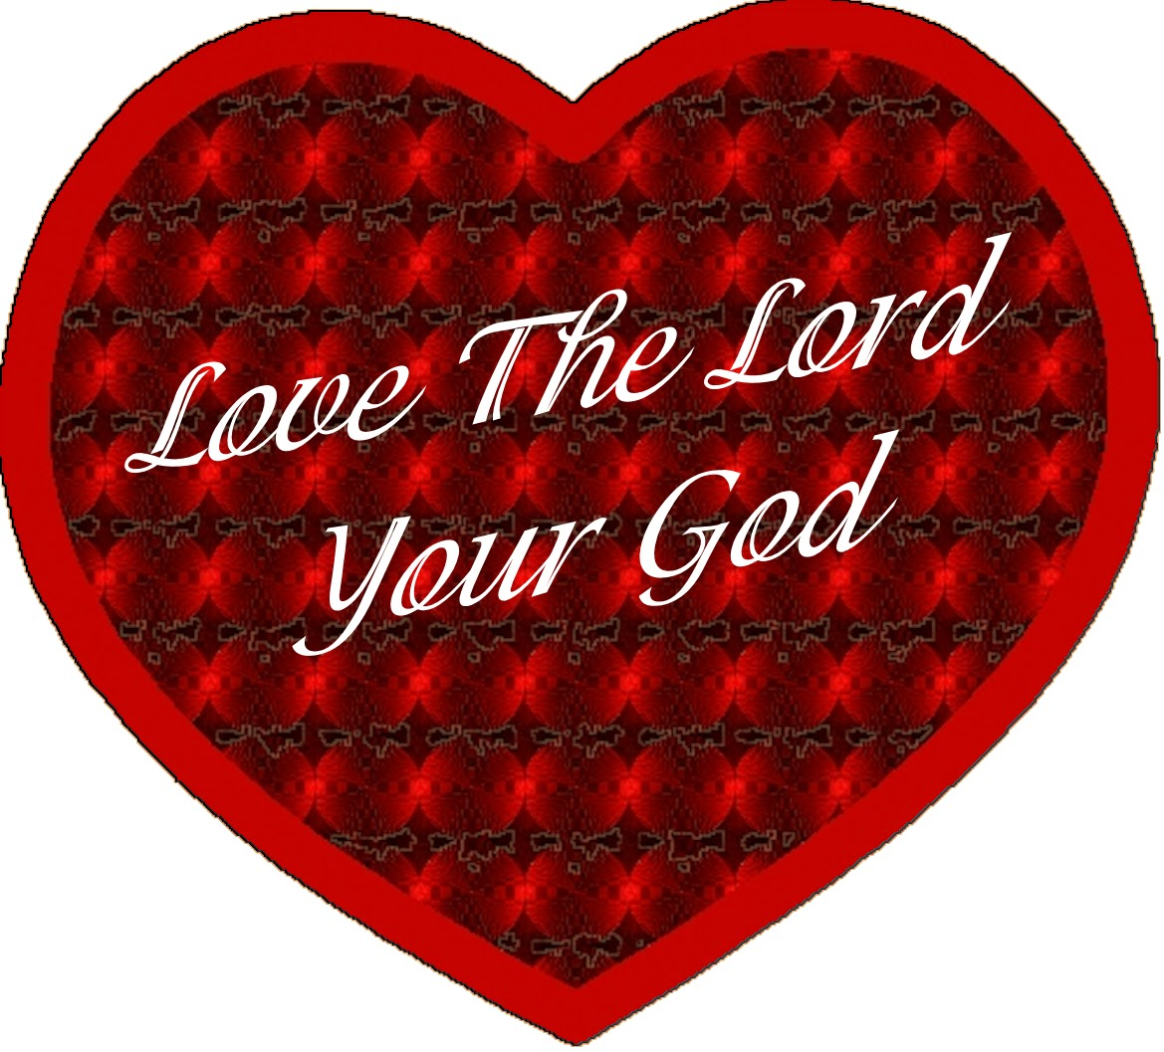
John 15:12-16
¹² My command is this: Love each other as I have loved you. ¹³ Greater love has no one than this: to lay down one’s life for one’s friends. ¹⁴ You are my friends if you do what I command. ¹⁵ I no longer call you servants, because a servant does not know his master’s business. Instead, I have called you friends, for everything that I learned from my Father I have made known to you. ¹⁶ You did not choose me, but I chose you and appointed you so that you might go and bear fruit—fruit that will last—and so that whatever you ask in my name the Father will give you.

Slide 17
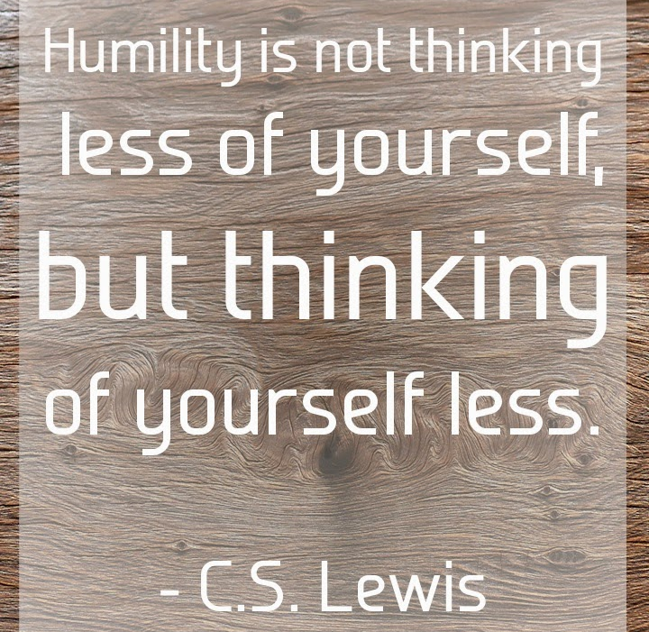
Humility
Our call to serve is to be stamped with his word and filled with his Spirit.
As “branches” on his vine, we will be guided by his Word and will.

Slide 18
Spiritual Sensitivity
Love the church and be sensitive to her needs.
Everything must take place within the framework of ministry and mission.
Question: what is the will of God in these matters?
How does the maintenance and improvement of this building better enhance the proclaiming of the gospel?

Slide 19
Teamwork Capabilities
The trustee functions as a member of the larger team, the CHURCH, and is always responsible and accountable to them.
The trustee is one of a number of trustees and should know how to work with a small group of people without having to dominate them.

Slide 20
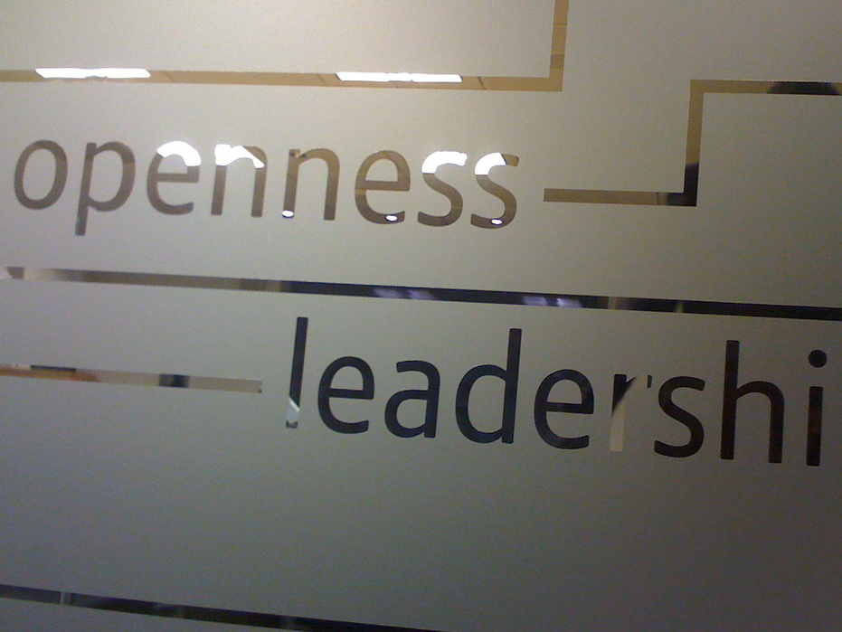
openness
Must be open to change, flexible in opinions, and willing to learn.

Slide 21
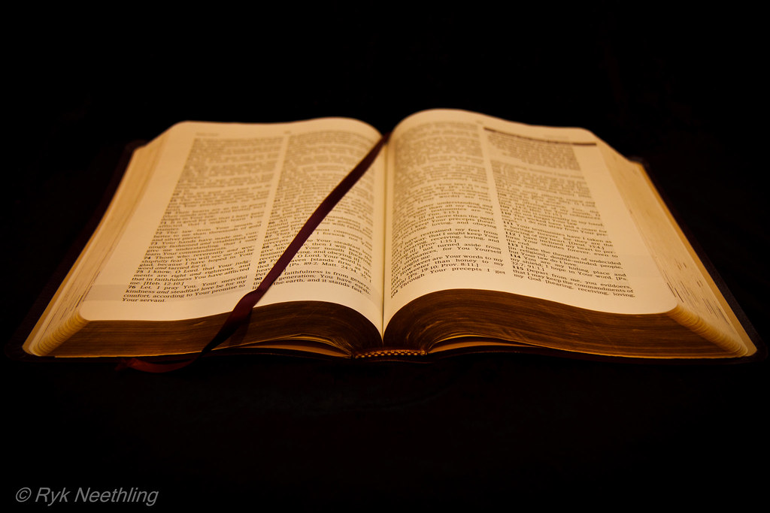
Proverbs 11:14
Where there is no counsel, the people fail; But in the multitude of counselors there is safety.

Slide 22
Skills in property and financial matters
Impeccable character, innate honesty, and the ability to use good judgment in property and financial decision making.

Slide 23
Trustees cannot personally be in a toxic relationship with money and possessions.

Slide 24
Helpful for the ministry
Trustees will benefit from having one or more of these spiritual gifts: servanthood, helping, discernment, leadership, administration, and giving.
Useful knowledge and skills for this position are knowledge of property and asset management, ability to listen to and communicate with people of all ages and the ability to work with other ministry leaders.

Slide 25
Romans 12:6-8
Trustees should show genuine interest in responding to the hopes and concerns of people in the community and show willingness to partner with community interests.

Slide 26
Marks of a Trustee Member
Every church should have a bylaw description of what a trustee does.
QUALIFICATIONS
Set up ideals toward which to aim.
Prayerfully seek out these individuals.

Slide 27
This

Slide 28
Although trustees are necessary for the effective and efficient operation of a local church body, it is not a biblically created office. Trustees are a mandate of the State whose responsibility is to the physical property of the church.
The Trustees will hold in trust the church property. They shall have no power to buy, sell, mortgage, lease or transfer any property without a specific vote of the church authorizing each action. It shall be the function of the trustees to affix their signatures to legal documents involving the sale, mortgage, purchase, or rental of property or other legal documents where the signatures of trustees are required.
The trustees shall be responsible for the upkeep and maintenance of all church properties and equipment. When there is a need for repairs, renovations, purchase or sale of any church property, the trustees shall be the legally constituted body to transact such business upon the authorization of the church, which shall, at all times, be the active members.

Slide 30
Ensure Church Building is:
At all times, heated, cooled and lighted adequately;
At all times clean and open for all services, ministry activities and meetings; (SANITIZED)
At all times building is secure including when it is occupied and being used;
At all times the grounds are kept free of debris, trash, and all safety hazards;
At all times the grass is kept cut, shrubbery is pruned, and sidewalks clean;
At all times the sidewalks are clear of snow or ice and parking lot is safe.

Slide 32
To utilize spiritual gifts, talents, and resources in stewardship to the church
To be active participants in the ministry of teaching, training, and worship
To possess the ability to lead persons to Christ
To be faithful stewards over God’s household affairs
To manage assigned responsibilities with an openness to new ideas and creativity
To utilize and manage available resources for completion of tasks
To prayerfully make recommendations to the Pastor and/or Deacons
To remain proficient and organized in the execution of all responsibilities

Slide 33
The 4M Factor
Management and Administration
Maintenance
Ministry
Mission

Slide 34
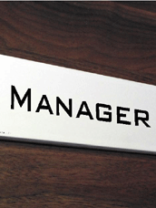
Management and Administration
Originates in Old Testament where Israel is guided toward strong administrative principles in order to effectively carryout the purposes of God through his people into the world.

Slide 35
Management Team
Trustees are a management team, under the leadership of the pastor, who is the general manager.
TWO MAJOR CONCERNS:
1. Will there be money enough to carry out the voted mandates of the membership.
2. Make certain that the money is spent according to the will of the people.

Slide 36
Full Responsibility
Care and maintenance of all church buildings and property.
Oversee the general use of the building’s rooms.
Very responsible and time-consuming task.

Slide 37
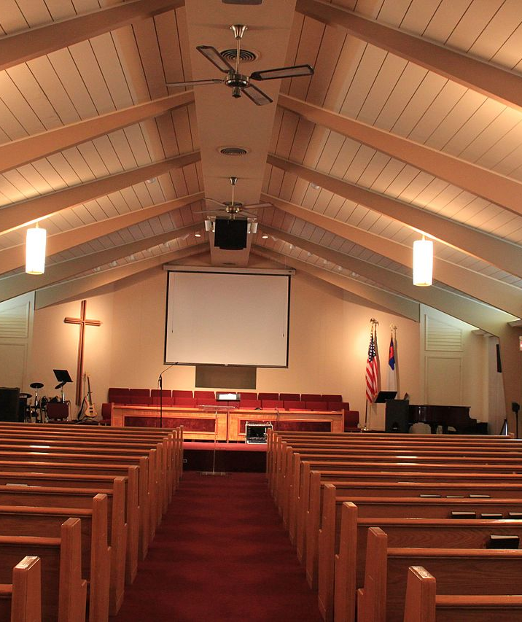
MINISTRY Numbers 4:1-15 Sons and Daughters of Kohath
Provide the means for people to be ministered unto and to become ministers to others.
The cleanliness of the sanctuary, the condition of pews, the functioning of lights, the temperature of the building—all contribute to making ministry possible.
The eyes, ears and souls of the people can be opened or closed according to the functioning of the trustees.

Slide 38
In Mission
Every trustee ministry should do a very thorough checkup of its exterior and interior to ask whether they are adequate expressions of God’s love and reach to people.
The same God who so loved that he gave his Son also gave the church to service the community.
Is the church a mission center or a memorial to those who have passed on?

Slide 39
FUNCTIONS OF THE TRUSTEE MINISTRY
Trustees officially transact business of the congregation for property and title.
They are to maintain a clear and comprehensive understanding of all business engagements of this congregation, and they must know the contents of all written contracts and agreements for which the congregation is financially responsible.

Slide 40
The church is not responsible for any contracts written without approval by the Trustee Ministry.
Furthermore, trustees will not make any verbal contracts on behalf of the church.

Slide 41
Functions of the trustee ministry
Trustees are to maintain an accurate inventory of assets and liabilities of both physical and fiscal natures.
Trustees are responsible for securing items of inventory against theft and misplacement.
They are required to conduct periodic surveys for necessary building and property maintenance.

Slide 42
Each trustee is urged to maintain a close relationship with the Pastor. He/she is to remember that the Pastor is the final interpreter of matters controversial in nature, especially if the peace and harmony of the congregation are at stake.

Slide 43
Functions (continued)
It is imperative that the trustees communicate regularly with the Pastor in the interest of coordination throughout the various aspects of the program. They are workers together with Christ and their fellowship of service must be based upon the purest foundation of mutual trust and cooperation.

Slide 44
Duties
1. Maintenance and Building Repairs
2. Facility use
3. Budget and Finance
4. Legal contracts
5. Purchasing agents
6. Transportation Guidelines

Slide 45
The System in Which You Work
Manage the monies of the congregation responsibly.
There must be proper control and open accountability

Slide 46
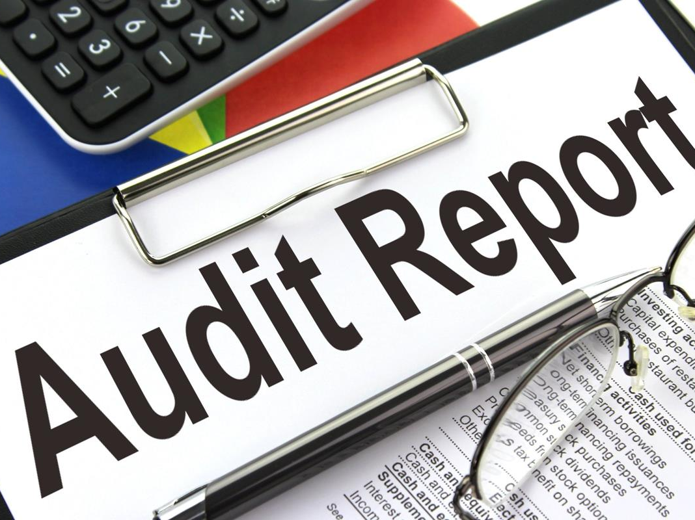

Slide 47
Purpose of a Church Budget
Provide a means for its dream to be set down with price tags attached.
It is a measurement tool.

Slide 48
Cash Flow
The trustees have been entrusted with money from others and should keep in mind at all times their responsibility to those persons.
Trustees should always be prayerful in monitoring the cash flow as an indicator of the spiritual health of the membership.
Cash flow is crucial to the church’s future planning as the blood pressure of a patient in a doctor’s office is crucial to his or her future life plan.

Slide 49
The Mission and the Money
Too often those who are responsible for budget management and control are so caught up in the figures and the pressures to keep up buildings that they lose sight of the mission behind it all.
There is an inextricable link between money management and mission enthusiasm.
If your church wants to be around in ten years, then it had better keep track of its money and keep focused on its mission.

Slide 50
St. Matthew 10:7-8
And proclaim as you go, saying, ‘The kingdom of heaven is at hand.’ Heal the sick, raise the dead, cleanse leper, cast out demons. You received without paying; give without pay.
Jesus was commissioning them to the highest purpose, the healing of lives and the coming kingdom.
That trust has been given to us, and the money in our hands is merely one of many tools to enable God’s plan completion.

Slide 51
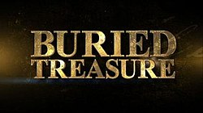
For the Kingdom
Inevitable Question:
What is the best method for raising the money needed to support the ongoing ministry of the church?

Slide 53
Matthew 6:19-21
“Do not lay up for yourselves treasures on earth, where moth and rust destroy and where thieves break in and steal; ²⁰ but lay up for yourselves treasures in heaven, where neither moth nor rust destroys and where thieves do not break in and steal. ²¹ For where your treasure is, there your heart will be also.

Slide 54
A God Approved Ministry
1 Thessalonians 2:3-4 (NIV)
For the appeal we make does not spring from error or impure motives, nor are we trying to trick you. ⁴ On the contrary, we speak as those approved by God to be entrusted with the gospel. We are not trying to please people but God, who tests our hearts.

Slide 55
APPROVED
The word "approved" means to have been tested and to have passed the test successfully. The apostle is effectively saying: "God has set His seal of approval on my ministry."
EXERCISING ONE'S GIFTEDNESS - A ministry that is approved of God involves the call of God.
DOING IT GOD'S WAY - Paul says in verse 3, "For the appeal we make does not spring from error or impure motives, nor are we trying to trick you." God-approved ministry is always done God's way.

Slide 56
PURSUING GODLINESS - Even when we are serving God in the right role, using our spiritual gifts the right way, our ministry will not be approved of God if our lives are not characterized by the pursuit of godliness.

Slide 57
STEWARDSHIP
ACKNOWLEDGING STEWARDSHIP - The ministry that pleases God involves faithful stewardship. In verse 4, Paul says: "We have been entrusted with the gospel." In other words, we are stewards of the gospel.
If our ministry is to bring pleasure to God, then our hearts, our minds, our souls, our whole beings need to be gripped by the fact that we are stewards entrusted with the gospel. Stewardship involves privilege and responsibility.

Slide 58
Pleasing God, Not Men
Paul says: "We are not trying to please men but God, who tests our hearts.“
The singular goal of our lives is to have our ministry aimed at pleasing God and God alone.

Slide 59
Word of Affirmation
CLOSING PRAYER

Slide 60
RESOURCES
Tibbetts, Orlando L., The Work of the Church Trustee, Judson Press, Valley Forge, PA, 1979.
New International Version of Holy Bible

